Slide 1


BOOKandGO
A web application offers a convenient online taxi booking service.
SUPERVISOR： Mr. Green Bee
MEMBERS: Nguyễn Văn Tâm (LEADER)
Trần Thanh Hải
Tăng Hoàng An
Nguyễn Trọng Ngôn
Siêu Ngọc Tài
Dương Ngọc Phú

Slide 2


INTRODUCTION
01
Brief description
Problem definition , proposed solution, boundary
AGENDA
02
IMPLEMENTATION
Design & Implement system
03
OUTCOME
Value and Challenges
04
FUTURE PLAN
Our plan in the future

Slide 3

01
INTRODUCTION
Brief description
Problem definition , proposed solution, boundary

Slide 4



INTRODUCTION
Demand for taxis through the application is increasing
Traditional taxi model operating costs are increasing. Therefore, the need to upgrade the operating system towards using car booking applications is increasing.
CURRENT SITUATION
The number of people who regularly use the car booking application is from 2013-2018

Slide 5




INTRODUCTION
OUR PROPOSAL
Book and Go
Driver
Customer

Slide 6










Technology

Slide 7


INTRODUCTION
BOUNDARY
System only support Vietnamese Web User.

Slide 8
02
IMPLEMENTATION
Design and Implement system

Slide 9
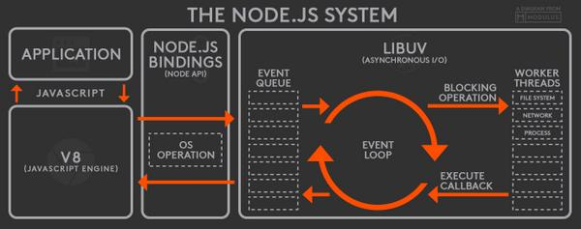
IMPLEMENTATION
SYSTEM ARCHITECTURE
Notes:
After analyzing the software requirements,
We know that a web application is used for testing, in which the test process is quite long (depending on the test function). We have to choose a framework for one page support (Ajax and Cached all)

Slide 10
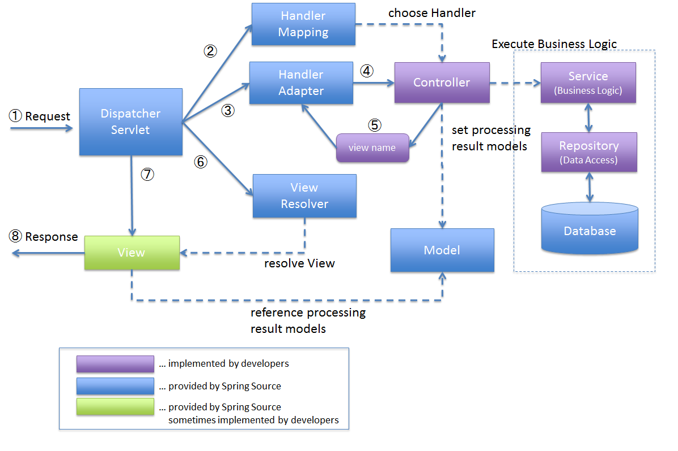
IMPLEMENTATION
SYSTEM ARCHITECTURE
Notes:
After analyzing the software requirements,
We know that a web application is used for testing, in which the test process is quite long (depending on the test function). We have to choose a framework for one page support (Ajax and Cached all)

Slide 11





IMPLEMENTATION
SYSTEM ARCHITECTURE
Dispatcher
User Web Browser
HTTP Response
View
Interceptor
Server
Database
HTTP Request
Pre Handle
Post Handle
Affter Completion
Data
Controller
Service
DAO
Model
Notes:
After analyzing the software requirements,
We know that a web application is used for testing, in which the test process is quite long (depending on the test function). We have to choose a framework for one page support (Ajax and Cached all)

Slide 12



IMPLEMENTATION
SERVER CONFIGURATION
User
Tomcat
Database
http//:192.168.123.86:3306
http//:localhost/
Admin
http//:192.168.123.124:8080
Database
Apache 2
Customer
http//:192.168.123.89:8080
http//:192.168.123.98:80
Notes:
After analyzing the software requirements,
We know that a web application is used for testing, in which the test process is quite long (depending on the test function). We have to choose a framework for one page support (Ajax and Cached all)

Slide 13

IMPLEMENTATION
ALL OF NON - FUNCTION
System Function
Login – Signup
Logout
Edit profile
System

Slide 14


IMPLEMENTATION
ALL OF MAIN FEATURES
Book Car
Search Locations
Book Car
Payment
Review
Accept Trip
Show Location and road map
Payment
Analysis trip
Manager
Staff
Trip
Discount
Analysis
Sale
Trips
Customer
Driver
Admin

Slide 15
Customer
Book Car
Search Locations
Book Car
Payment
Review
Book car:
Choose the best route on the map
Select the nearest driver
Support online chat with drivers
Multimedia payment
Earn points for each trip
Customer

Slide 16

BUILD SITEMAP
Issue & Solution
1. Demand for travel without knowing the road.
Choose the best route and driver on the map
Draw the best route
Choose the nearest driver
2. Cost and convenience.
Best Price and use every where

Slide 17



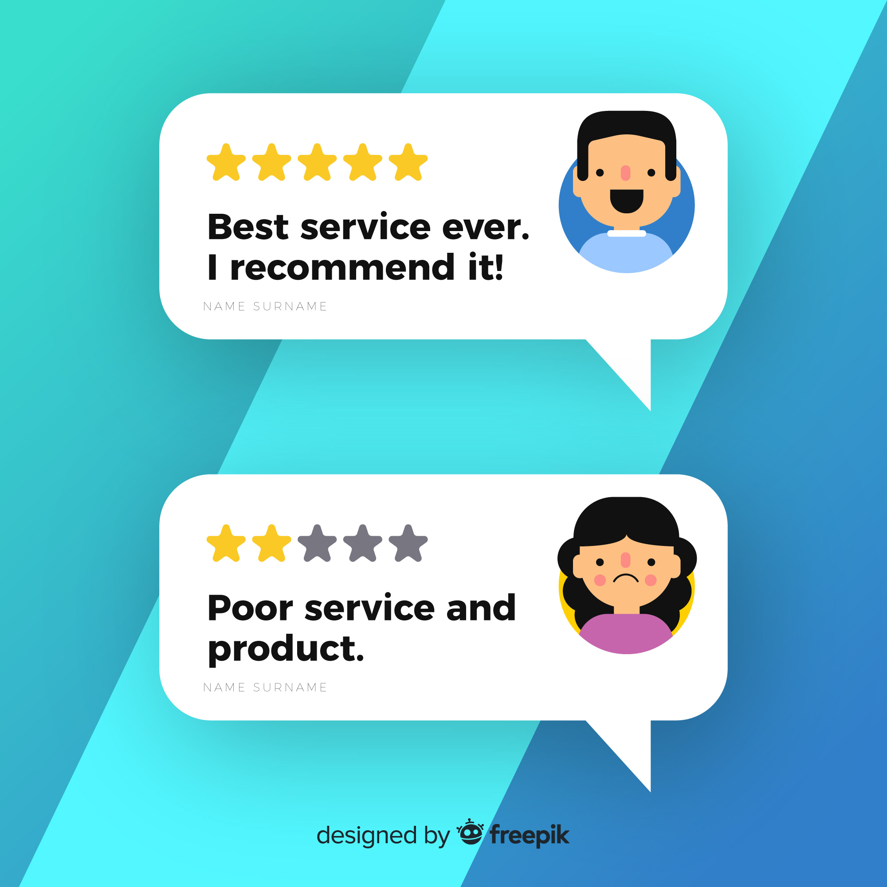


BUILD SITEMAP
Process
2. Waiting for
Driver
3. Picked up and
Go
1. Log in system
Customer
Book Car Page
Website List
4. Payment
4. Rating

Slide 18
Driver
Accept Trip
Show Location and road map
Payment
Analysis trip
Book car:
Choose the best route on the map
Select the nearest driver
Support online chat with drivers
Earn points for each trip
Driver

Slide 19
BUILD SITEMAP
Issue & Solution
1. Increase income
Find Customer for driver
2. High cost when looking for guests
Best directions for drivers

Slide 20

BUILD SITEMAP
Process
1. Log in system
2. Accept Trips
3. run
Manager
Driver Main
Map Located
Map Runtime
4. Payment

Slide 21
Manager
Staff
Trip
Discount
Analysis
Sale
Trips
Admin
Admin

Slide 22
BUILD SITEMAP
Issue & Solution
1. Management issues
Update data realtime with database
2. Statistical issues
Update data and draw graphs

Slide 23


SPELLING TEST
Process
2. Go to Spelling Test Screen
3. Choose pages
option
1. Login as Staff role
Page Option
Popup
Admin
Spelling Test Screen
4. Save
page option
Staff Page
5.Send test
command
7. Save results
6. View suggestion
Action: Learn / Ignore
Result table
Spelling Test
Screen

Slide 24
03
OUTCOME
Value and Challenge

Slide 25

ASSESSMENT
VALUE
Improve quality serving;
Create jobs for the community;
Helping society save costs;
Providing safe solutions for travel.
Notes:
Kiểm tra nhiều thứ ở một nơi.
Đo lường và nâng cao chất lượng của trang web.
Sau khi kiểm tra kết thúc, nhân viên có thể lưu và xuất kết quả dưới dạng báo cáo.
Nhân viên có thể xem các báo cáo cũ (Xem báo cáo lịch sử).
Đánh giá tính đầy đủ của các tính năng trang web.
Làm cho trang web lớn hơn và chuyên nghiệp.

Slide 26

ASSESSMENT
DISADVANTAGE
Only support for Vietnamese user.
Notes:
Hệ thống của chúng tôi chỉ hỗ trợ tiếng anh
Cần có internet để sử dung hệ thống chúng tôi.

Slide 27
04
FUTURE PLAN

Slide 28

FUTURE PLAN
Complete the multimedia payment function.
Complete the discount system and automatically identify eligible customers and send customers automatic mail code via email.
Additional trip tracking function for admin.

Slide 29
QUESTION
AND ANSWER

